Slide 3
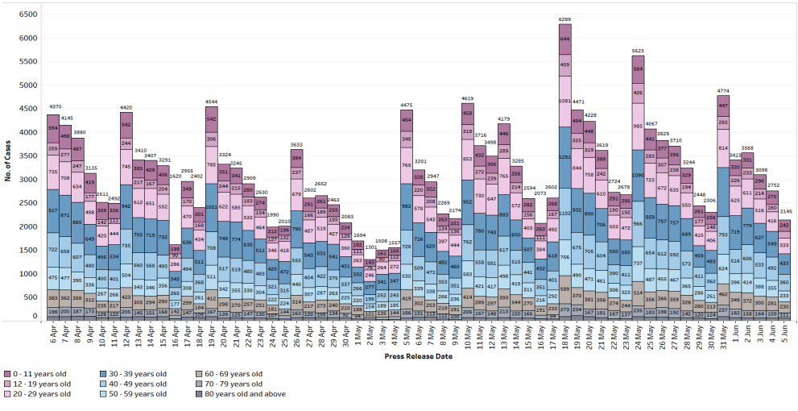

Slide 4
What-Why-How
What
To show the number of ART and PRC positive case by day
Why
To inform Singaporeans on the latest COVID situation
How
Usage of bar charts

Slide 5
Issues
Multiple data classes
Unable to compare trends for different days based on data class

Slide 6
Improvements
Segregating the bar charts into by data classes

Slide 7
Critique Two Tweet Archivist Desktop

Slide 8
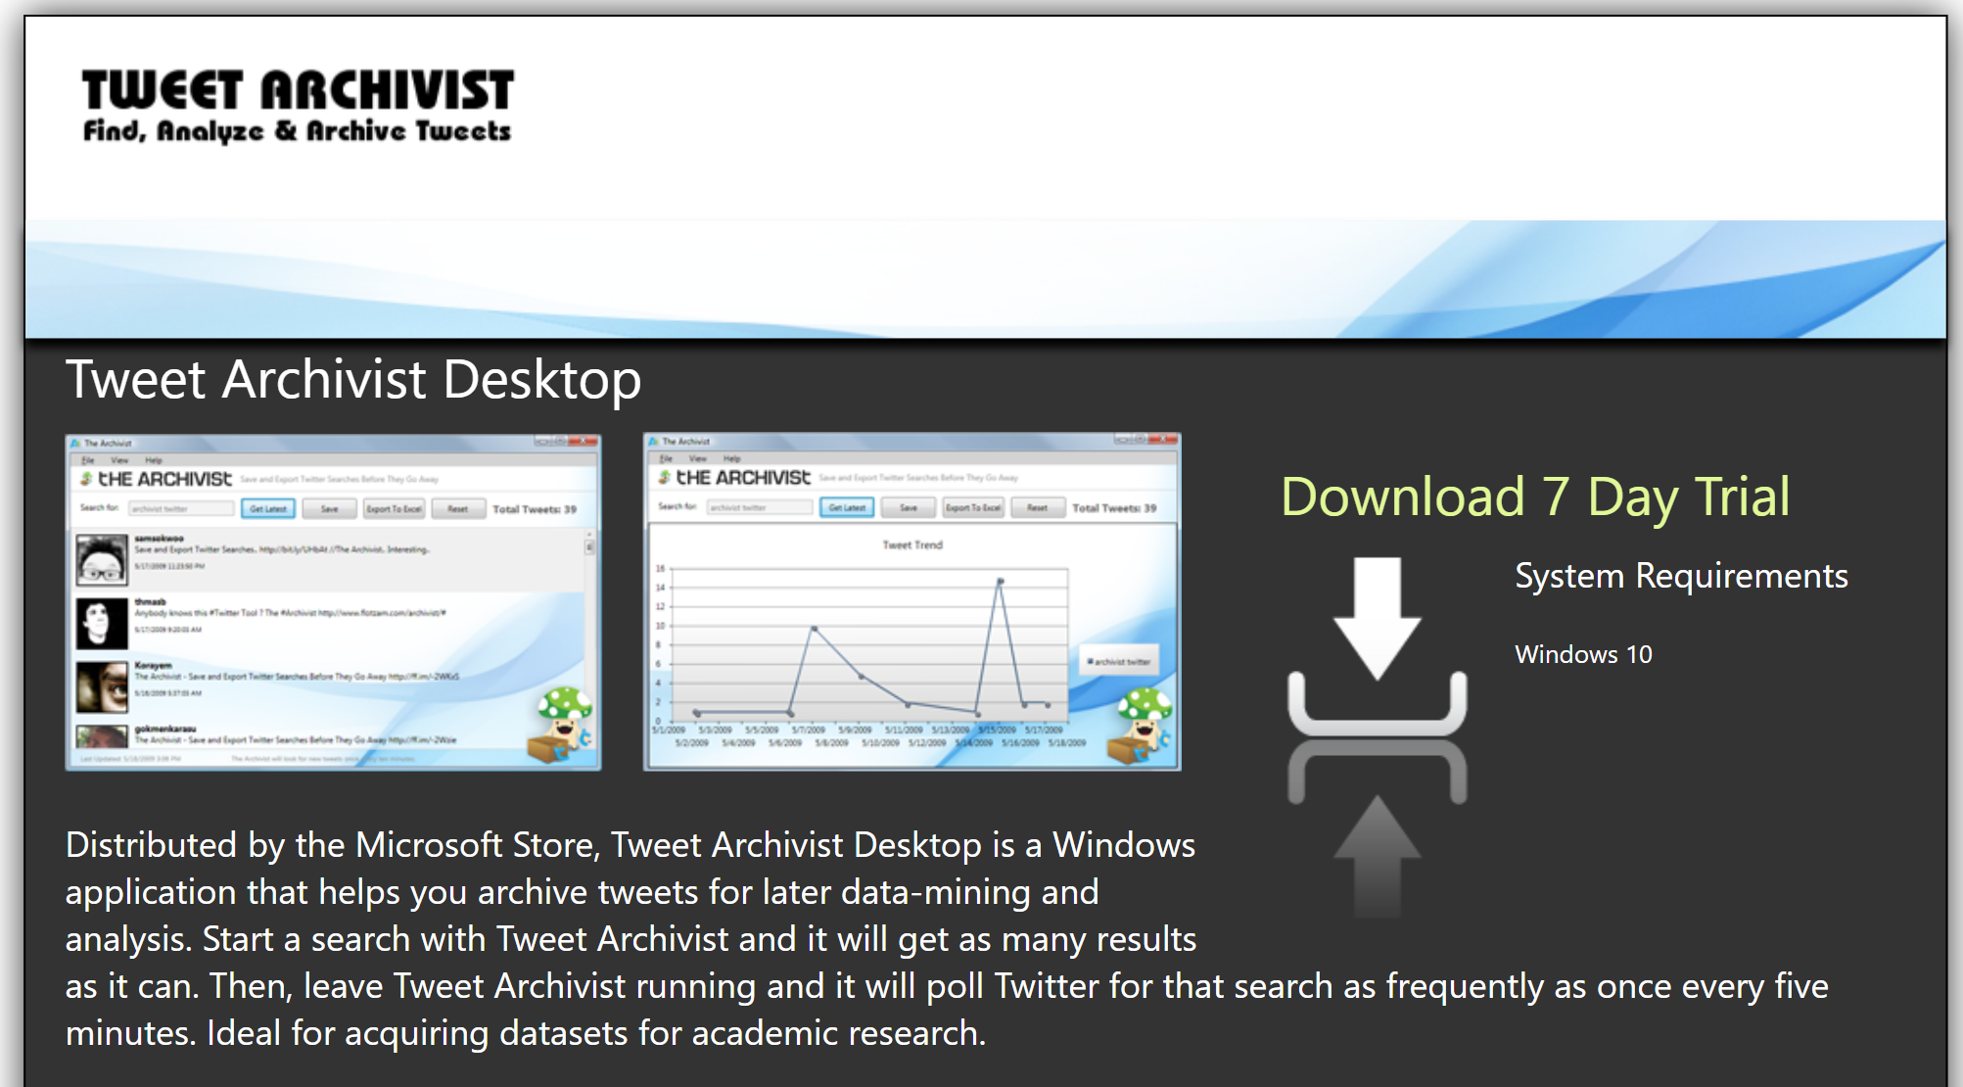

Slide 9

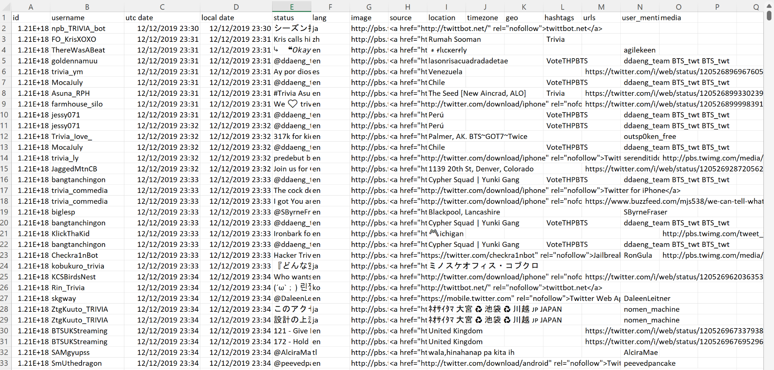
Raw Data

Slide 10
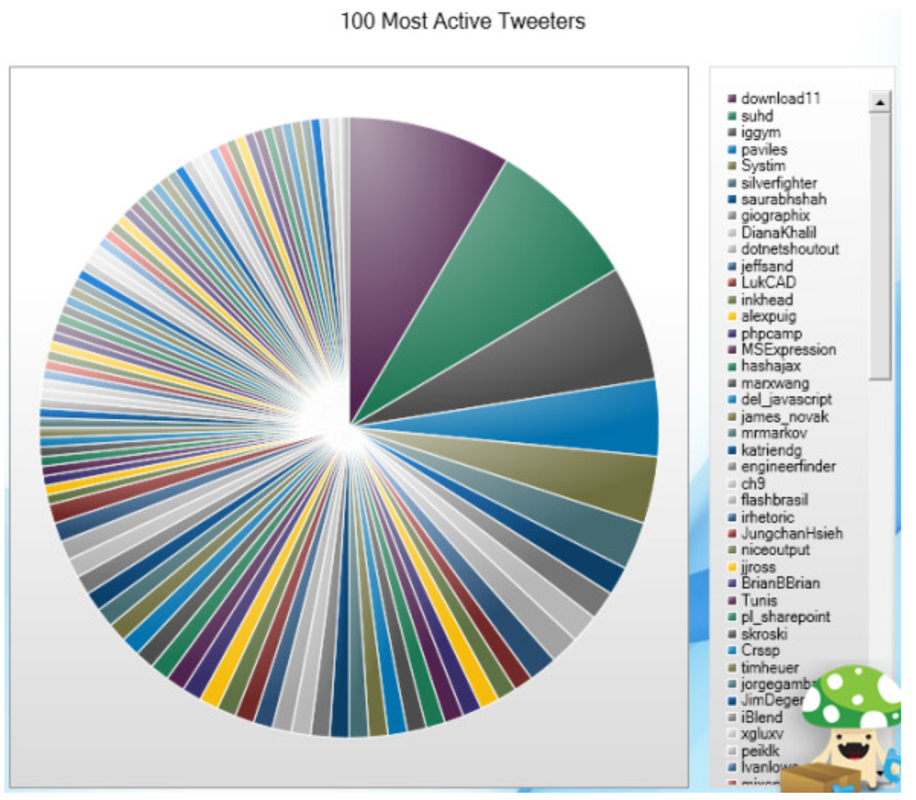


1. Data
Archivist Desktop conducts data mining from twitter and sieved out the 100 most active tweeters based on its search criteria
Username 100 most active tweeters
Hidden Percentage / Ratio The list is in descending order
Raw data is available in json and excel format
Notes:
https://www.quora.com/What-are-examples-of-bad-data-visualization-thats-misleading-and-confusing
https://chandoo.org/wp/nightmarish-pie-charts/

Slide 11
2. Task
To create awareness for which tweeter are in the billboard for “Top 100 Most Active Tweeters”
To inform viewers on which tweeter is more active than another tweeter
To show proportion ratio on the activeness for each tweeter
Notes:
https://www.quora.com/What-are-examples-of-bad-data-visualization-thats-misleading-and-confusing
https://chandoo.org/wp/nightmarish-pie-charts/

Slide 12
3. Idiom
Pie Chart All 100 most active tweeters are fitted into the pie chart. Colours are repeated and without any label.
Scrollable List The list is in descending order with repeated colour legend
Cartoon Logo A cartoon logo is located at the bottom right
Notes:
https://www.quora.com/What-are-examples-of-bad-data-visualization-thats-misleading-and-confusing
https://chandoo.org/wp/nightmarish-pie-charts/

Slide 13
4. Suggestion
Toggleable pie chart showing 10 records at once
Distinct colour with labels
Remove cartoon logo
Notes:
https://www.quora.com/What-are-examples-of-bad-data-visualization-thats-misleading-and-confusing
https://chandoo.org/wp/nightmarish-pie-charts/

